Slide 1
KELPA Admin & Scoring
Kansas Assessment Program

Slide 2
Learning Intentions
We are learning to navigate the Kite Educator Portal (EP) so that we can be better prepared to complete the human scoring of speaking and writing KELPA items.
Success Criteria
I can locate necessary rater materials in the Kite Educator Portal.
I can understand scoring guidance and expectations.
I can know where to get additional information if more questions arise.

Slide 3
What is KELPA?
The Kansas English Language Proficiency Assessment (KELPA) measures the English language proficiency of English learners (EL) and evaluates student progress toward such proficiency based on Kansas English Proficiency standards adopted in 2018.
Students are assessed across four domains: reading, writing, listening, and speaking.
All students who are identified as ELs must take KELPA, whether they are receiving English for Speakers of Other Languages (ESOL) services or not.
The assessment is delivered through the Kite Student Portal, except for a small number of paper-based writing items given only to kindergarten and first grade students.

Slide 4
Testing Window
Assessment | Domains | Grades | Estimated time to complete | Testing Window | Scoring | Who takes it?
KELPA | Four domains: Speaking* Writing* Listening Reading | K-12 | Varies | 2/3/25 To 3/14/25 | Human scoring completed by 4/7/25 | No exemption. Required for all identified EL students
*Human Scored

Slide 5
Why do I need this training?
You will be scoring the speaking and writing sections of the KELPA.
You are a Building or District Test Coordinator and will be responsible for training your staff who will be scoring test items.

Slide 6
KELPA Admin

Slide 7
2025 KELPA Overview
Test Design
Aligns with the 2018 Kansas EL standards
Fixed form, 4 test sessions (domain specific)
Tested Domains: Reading, Writing, Listening, Speaking
When administering the assessment, you may give the domains in any order.
Grade Band Tests: K, 1, 2-3, 4-5, 6-8, 9-12

Slide 8
KELPA Testing & Scoring Windows
Testing Window
February 3– March 14, 2025
Scoring Window
February 3– April 7, 2025

Slide 9
Tested Students
Students on monitored and transitional status do not take the KELPA.
Rostered Prior Year Proficient Table
Provides a list of students that are currently enrolled in KELPA (via KIDS TEST record) that have received an Overall Level 3 (Proficient) Score last year.
Located: Settings > Rosters > Rostered Prior Proficient
Notes:
We open with a solid new feature for KELPA right out of the gate. This feature is called Rostered Prior Proficient and it's going to be under Settings > Rosters and it will have it's own tab there called Rostered Prior Proficient. It will give you the State ID, name, Roster, school name and grade of students that are currently enrolled for KELPA which have attained proficiency in the last school year. We are excited for this to come out around December 2nd or a little before when a lot of you will start thinking about doing KELPA Enrollments. Once they are enrolled, Check this tab under rosters and you will have a table for who is proficient. Let us know if you have questions on that.

Slide 10
KELPA Administration/Scoring
Each district has the flexibility to determine when you will administer the KELPA assessment during the statewide window.
A licensed educator who is employed by the school district should administer the assessment.
A para, under the direction of a licensed educator, may proctor the KELPA assessment if they have gone through the required Test Security and Ethics training.
Each district has the flexibility to determine how you will score the assessment items in writing and speaking. However, all items must be scored by a licensed educator who is employed by the school district.

Slide 11
KELPA Testing Time
Each test session takes approximately 45-60 minutes
Estimated time based on number of test items indicates less time is needed, but to be safe, allocate 45-60 minutes

Slide 12
KELPA Item Count by Domain
 | Number of Items Computer Scored |  |  | Number of Items Educator Scored
Grade Band | Listening | Reading | Writing | Writing | Speaking
K | 23 | 19 | 6* | 4 | 10
1 | 25 | 25 | 9* | 4 | 10
2—3 | 25 | 24 | 15 | 4 | 10
4—5 | 25 | 22 | 13 | 4 | 10
6—8 | 25 | 21 | 15 | 3 | 10
9—12 | 24 | 23 | 14 | 3 | 10
* Student written response – use test booklet found in the Test Admin. and Scoring Directions

Slide 13
Special Circumstance (SC) Codes
Students that should take the KELPA but do not take the KELPA must have an SC Code entered.
Detailed information about SC Codes is available in the KELPA Test Coordinator Manual.
SC-11: KELPA students that cannot test in one specific domain due to a disability; must be approved by KSDE.

Slide 14
KELPA Monitoring Visits
KSDE and KAAC (Kansas Assessment Advisory Council) members oversee testing
If chosen, contact will be made before the testing window opens to confirm that a visit will be happening.
Districts will not be told the specific date that the visit will happen.

Slide 15
KELPA Scoring

Slide 16
Who has access to score?
Educator Portal users with the role of:
District Test Coordinator (DTC)
District User (DU)
Building Test Coordinator (BTU)
Building User (BU)
Teacher

Slide 17
Where do I go?
Kite Educator Portal (EP) – Used by educators to manage data, monitor test completion, and access reports.
Scoring is accessed through the EP - Used by educators and scoring professionals to score human-scored items such as open-ended or audio-capture items.
Scoring Matierials are found under the Help tab

Slide 18
Scoring Menu

Slide 19
Scoring Materials
Videos, manuals and other materials located on the Kansas Assessment Program (KAP) website are not considered “secure” test materials and can be accessed at any time.
The KELPA Test Administration and Scoring materials can be found under the HELP tab inside the Kite Educator Portal.
These secure materials are posted prior to the start of KELPA testing and can be accessed by district level users, building lever users, and teachers who are tied to KELPA.
The Test Administration and Scoring materials MUST BE KEPT SECURE AT ALL TIMES and shredded at the end of the scoring window.

Slide 20
Help Tab

Slide 21
KAP Website – KELPA Training Tab

Slide 22
KELPA Materials and Resources
Location: KAP Website
KELPA Test Coordinator Manual
KELPA Summative Test Administrator Manual
Kite Accessibility Manual
KAP Practice Test Guide
KELPA Training PowerPoint
Location: Kite Educator Portal Help Tab (Secure)
Rubrics for KELPA & KELPA Screener
Test Administration and Scoring Directions
Writing (Grade-band specific)
Speaking (All Grades in One)
KELPA Rater Training Materials
Writing (Grade-band specific)
Speaking (Grade-band specific)

Slide 23
SPEAKING: Simultaneous vs. Deferred Scoring
Scoring can be done in person as the students are recording (simultaneous) or after students have recorded their responses (deferred).
If you will be using simultaneous scoring for speaking questions, make sure you have your rubrics and a score-tracking sheet available.
All students are required to record speaking items regardless of the scoring option chosen.

Slide 24
Second-Rater Scoring
Simultaneous scoring is not available
If your school has more than 10 students testing in a grade level/grade band, you may be randomly selected to participate in second-rater scoring.
Students flagged for second-rater scoring are automatically flagged in Kite and the second-rater scoring option under scoring populates only students with the second-rater flag.

Slide 25
Scoring Portal

Slide 26
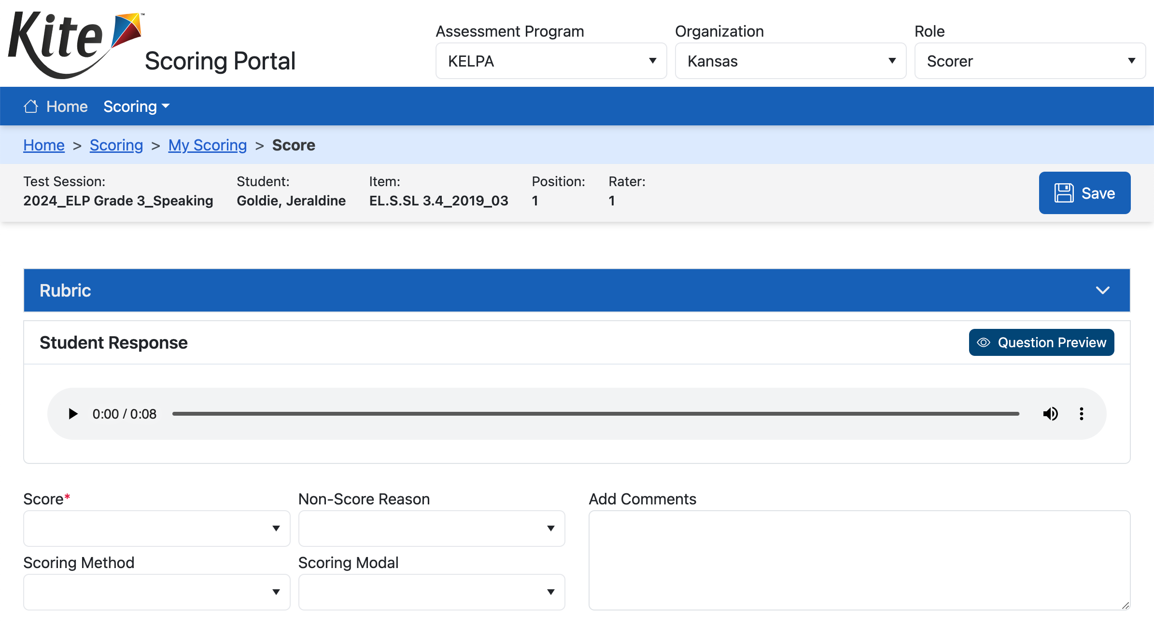
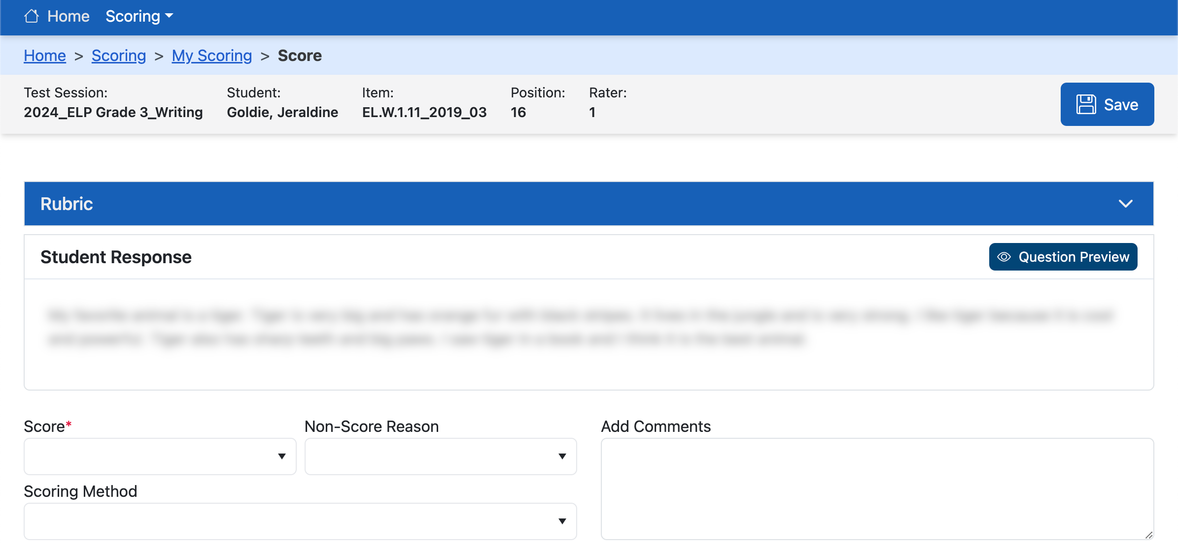
Scoring Items

Slide 27
Scoring Recommendations
Scoring may begin as soon as the testing window opens. It is not advised to wait until the end to complete all scoring.
It is suggested that the speaking and writing sections be administered earlier in the testing window, then the listening and reading sections. This allows for more time to complete the scoring of items.

Slide 28
Reminder: Kindergarten/1st Grade
Test Coordinators must print out writing booklets before testing begins.
Booklets can be found in the Kite Educator Portal under the Help tab.
Before booklets are destroyed at the end of testing, they must be scanned in (to PDF) and submitted in EP via the Survey tab. Scan by grade level.
Grade K file and a Grade 1 file.

Slide 29
Questions?
Please use the chat feature in Zoom to ask any relevant questions or clarifications.

Slide 30
Additional Training Available
Training Videos are available on the KAP website.
Scoring Calibration Office Hours*
January 22nd – 3:00 - 4:00 pm
*New this year

Slide 31
Getting Help
Kite Help Desk
855-277-9752
7:00 a.m.–5:00 p.m. CT M-F
Changes to 6:00 a.m. – 6:00 p.m. during the testing window
kap-support@ku.edu

Slide 32
KSDE ESOL Contact
Emily Scott ESOL/Title III Education Program Consultant Special Education and Title Services Team (785) 296-4941 escott@ksde.org

